Slide 1
Determining Customer Loan Eligibility
Batch-1 (CSE-A)
D. Chaitanya (20MQ1A0508)
N. C. V. S. Saini (20MQ1A0526)
M. Kaveri (20MQ1A0524)
B. Bharath Chandra (20MQ1A0538)
Under The Guidance of
Dr. B. R. S. Reddy
B. tech, M. Tech, Ph. D
Professor and Principal

Slide 2

CONTENTS
01
Abstract
02
Existing System
03
Proposed System
04
Requirements
05
Design
06
Analysis
07
Project Execution Screen Shots

Slide 3

Abstract
This application of predictive analytics, specifically using Random Forest models, to study and predict loan defaulters. Data from Kaggle is utilized for analysis, and performance measures such as sensitivity and specificity are computed to compare different models. The results indicate that Random Forest models produce varying outcomes, highlighting the importance of assessing various customer attributes beyond just financial status when granting loans. Logistic regression is employed to predict loan safety, following data cleaning to address missing values. The study is based on data from previous bank customers, focusing on parameters related to loan approval. The main objective is to predict loan safety and ensure sound lending decisions.

Slide 4
Existing System
Financial institutions like Banks, Housing Finance Companies, and Non-Banking Financial Companies (NBFCs) operate across rural, semi-urban, and urban areas, offering various types of loans such as housing, personal, and business loans. To assess customer eligibility for these loans, decision tree models are commonly used. However, the existing system has several drawbacks. Decision trees may lack accuracy, leading to incorrect lending decisions, and are prone to overfitting, especially with imbalanced data. Interpretability can be challenging, and these models may struggle to adapt to changing economic conditions. Moreover, human bias in the decision-making process can introduce inconsistencies and unfair treatment of applicants. Improvements in model accuracy and fairness can be achieved through the integration of advanced machine learning techniques and careful consideration of ethical and regulatory factors in lending practices. And mostly mediators run these algorithms so they give the data to banks or other financial services so the banks make decision to sanction the loan to people.

Slide 5

Proposed System
This project leverages the Random Forest machine learning algorithm to automate loan eligibility prediction based on diverse customer attributes within a dataset. Attributes encompass factors such as Gender, marital status, qualification, annual income, loan amount, and credit history. Random Forest efficiently identifies segments of eligible customers, enabling focused attention from financial institutions. Its strength lies in classifying data and establishing clear distinctions between categories. However, achieving high prediction accuracy hinges on factors like dataset quality, strategic feature selection, and meticulous model tuning. Despite Random Forest's proficiency with complex datasets and nonlinear relationships, sustaining accuracy necessitates continuous efforts in data preprocessing, feature engineering, and model validation. This automated approach significantly streamlines the loan application process, benefiting both customers and financial institutions alike.
.

Slide 6
Software Requirements
Hardware Requirements
OS : Windows or Linux
Python IDE : python 2.7.x and above
Tool : Jupyter notebook OR Google Colab
Language :Python Scripting
Operating system : windows, linux
Processor : minimum intel i3
Ram : minimum 4 GB
Hard Disk : minimum 250 GB

Slide 7
MODULES DESCRIPTION
Gathering the datasets: We gather all the data from the kaggle website and upload to the proposed model
Generate Train & Test Model: We have to preprocess the gathered data and then we have to split the data into two parts training data with 80% and test data with 20%
Run Algorithms: For prediction apply the machine learning models on the dataset by splitting the datasets in to 70 to 80 % of training with these models and 30 t0 20 % of testing for predicting
Obtain the accuracy: In this module we will get accuracies
Predict output: in this module, we will get output based input data

Slide 8
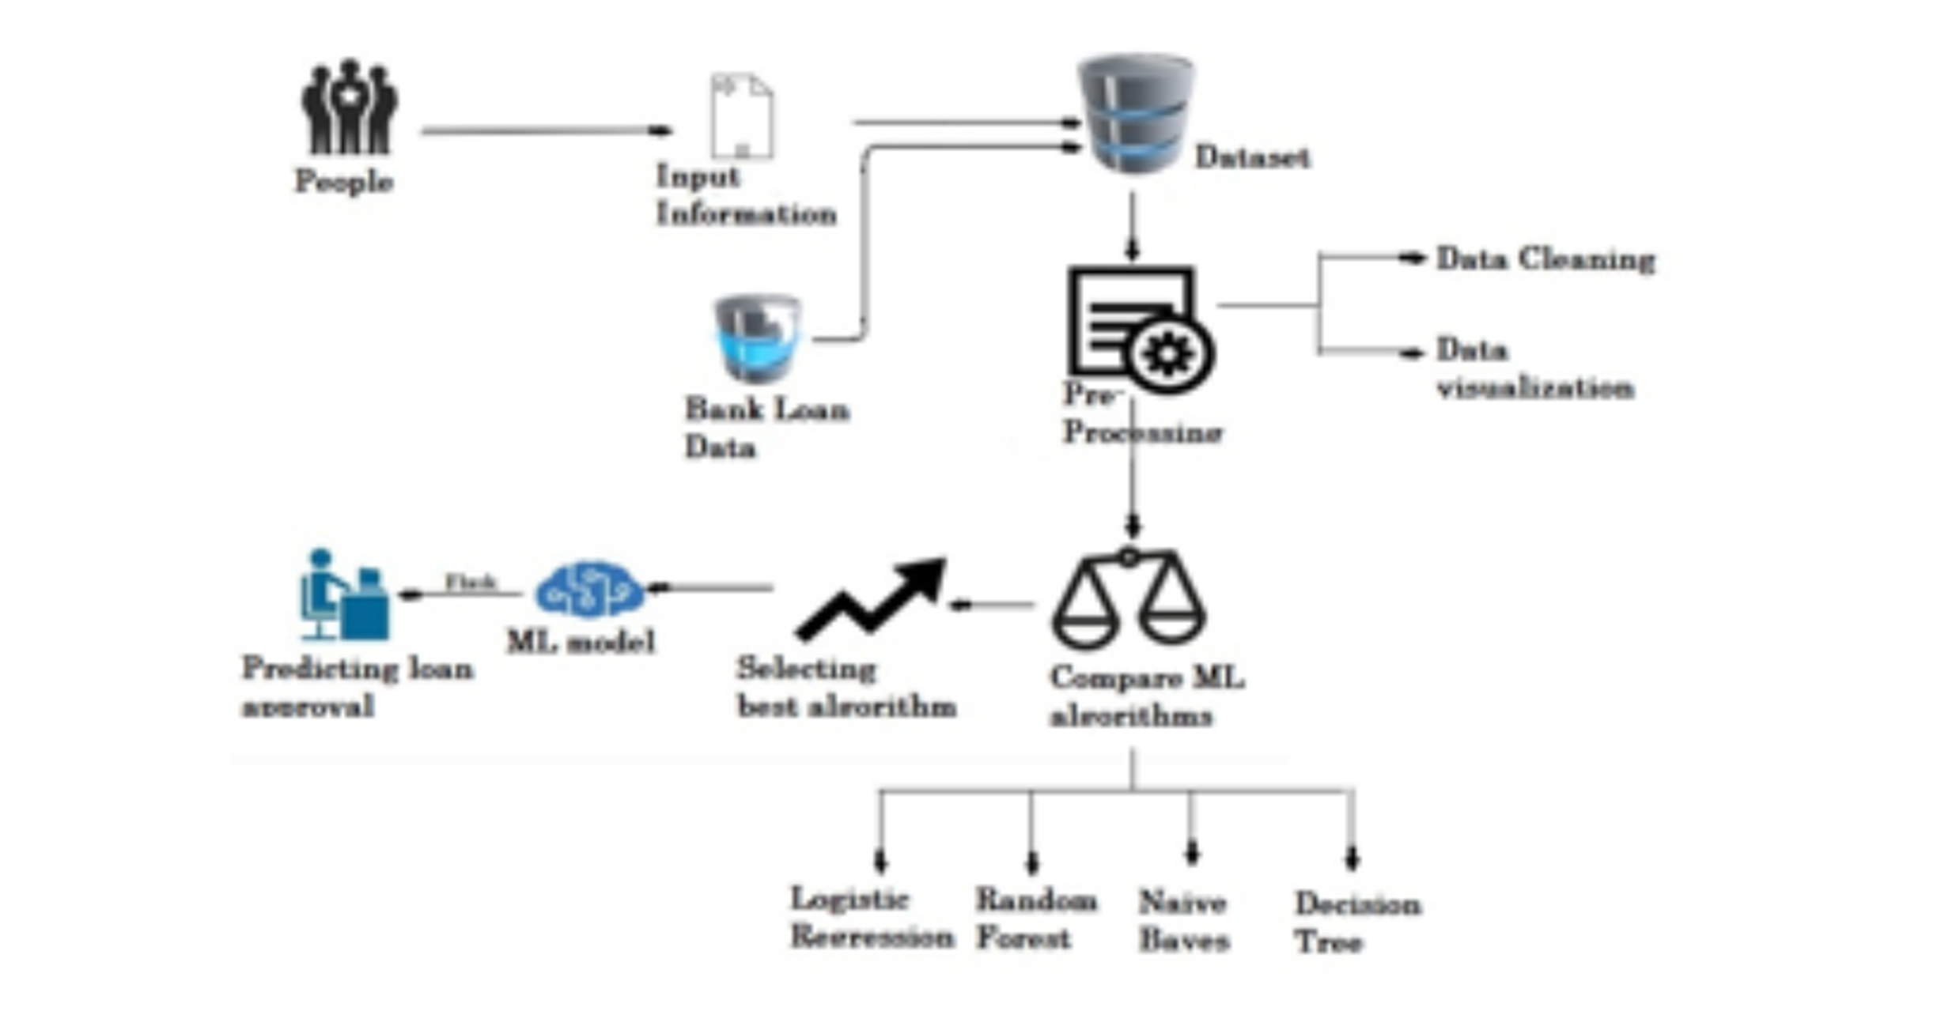
ARCHITECTURE

Slide 9
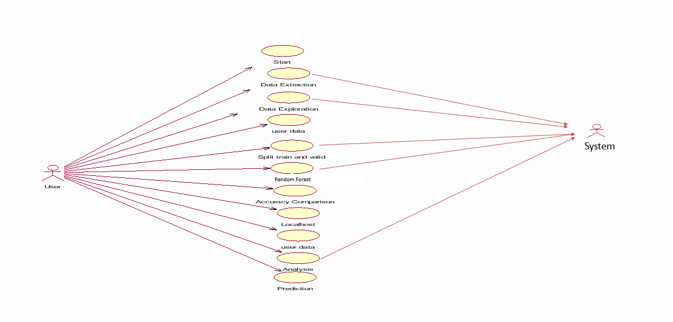
UseCase Diagrams

Slide 10
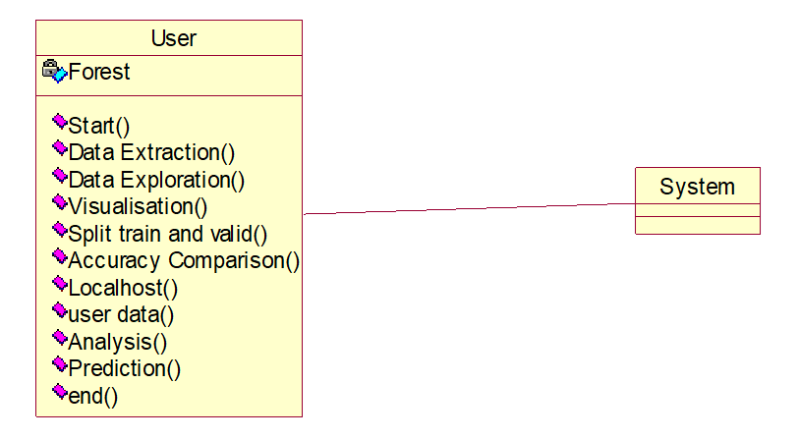
CLASS DIAGRAMS

Slide 11
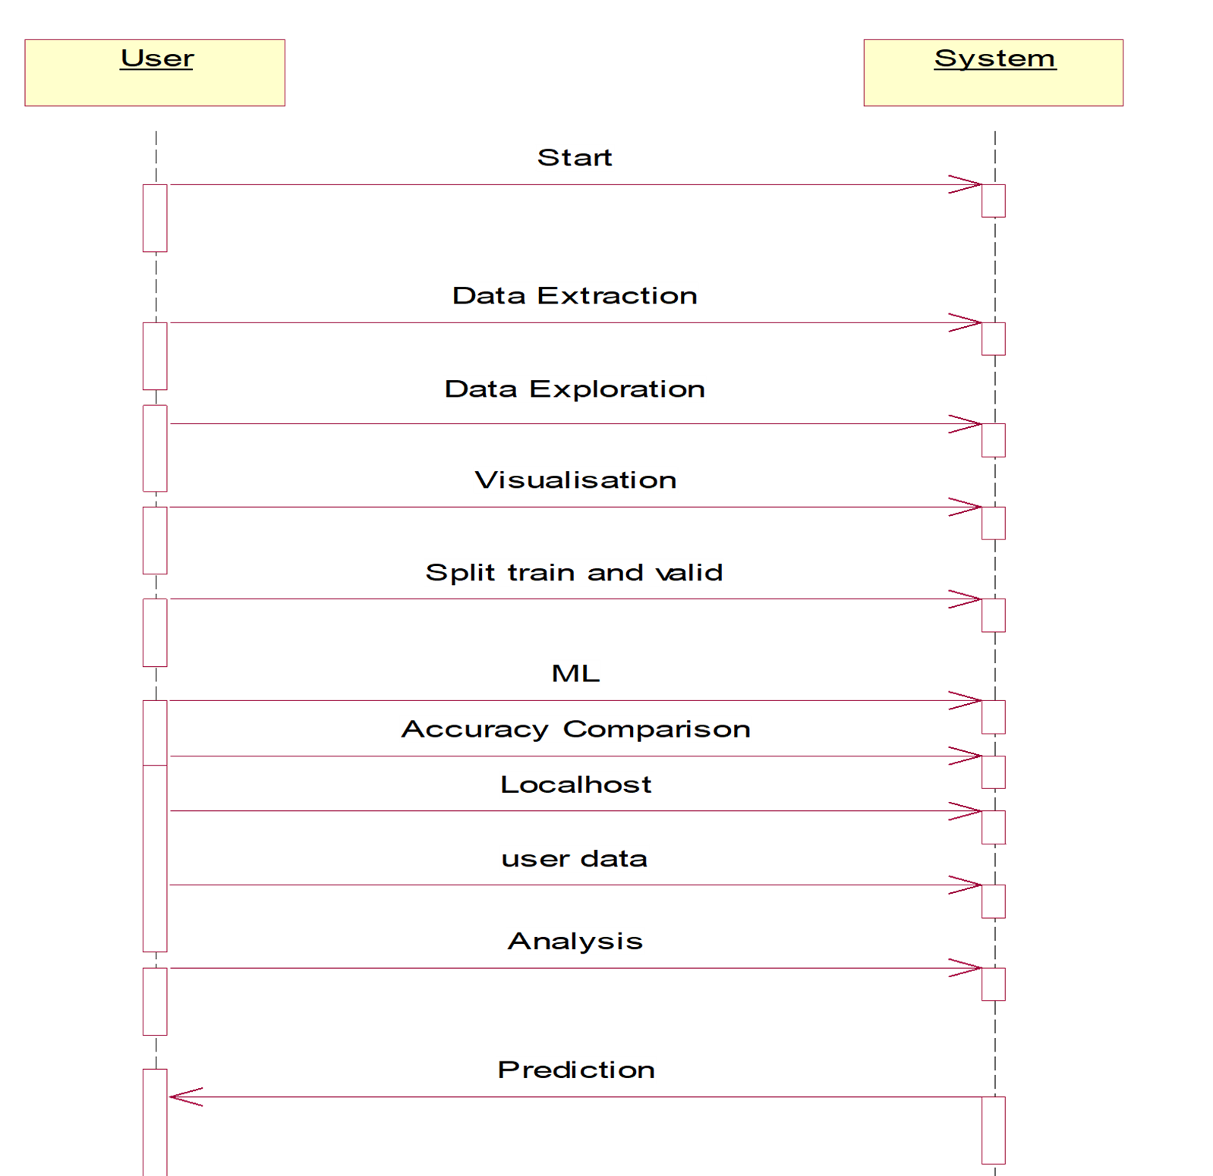
Sequence Diagram

Slide 12
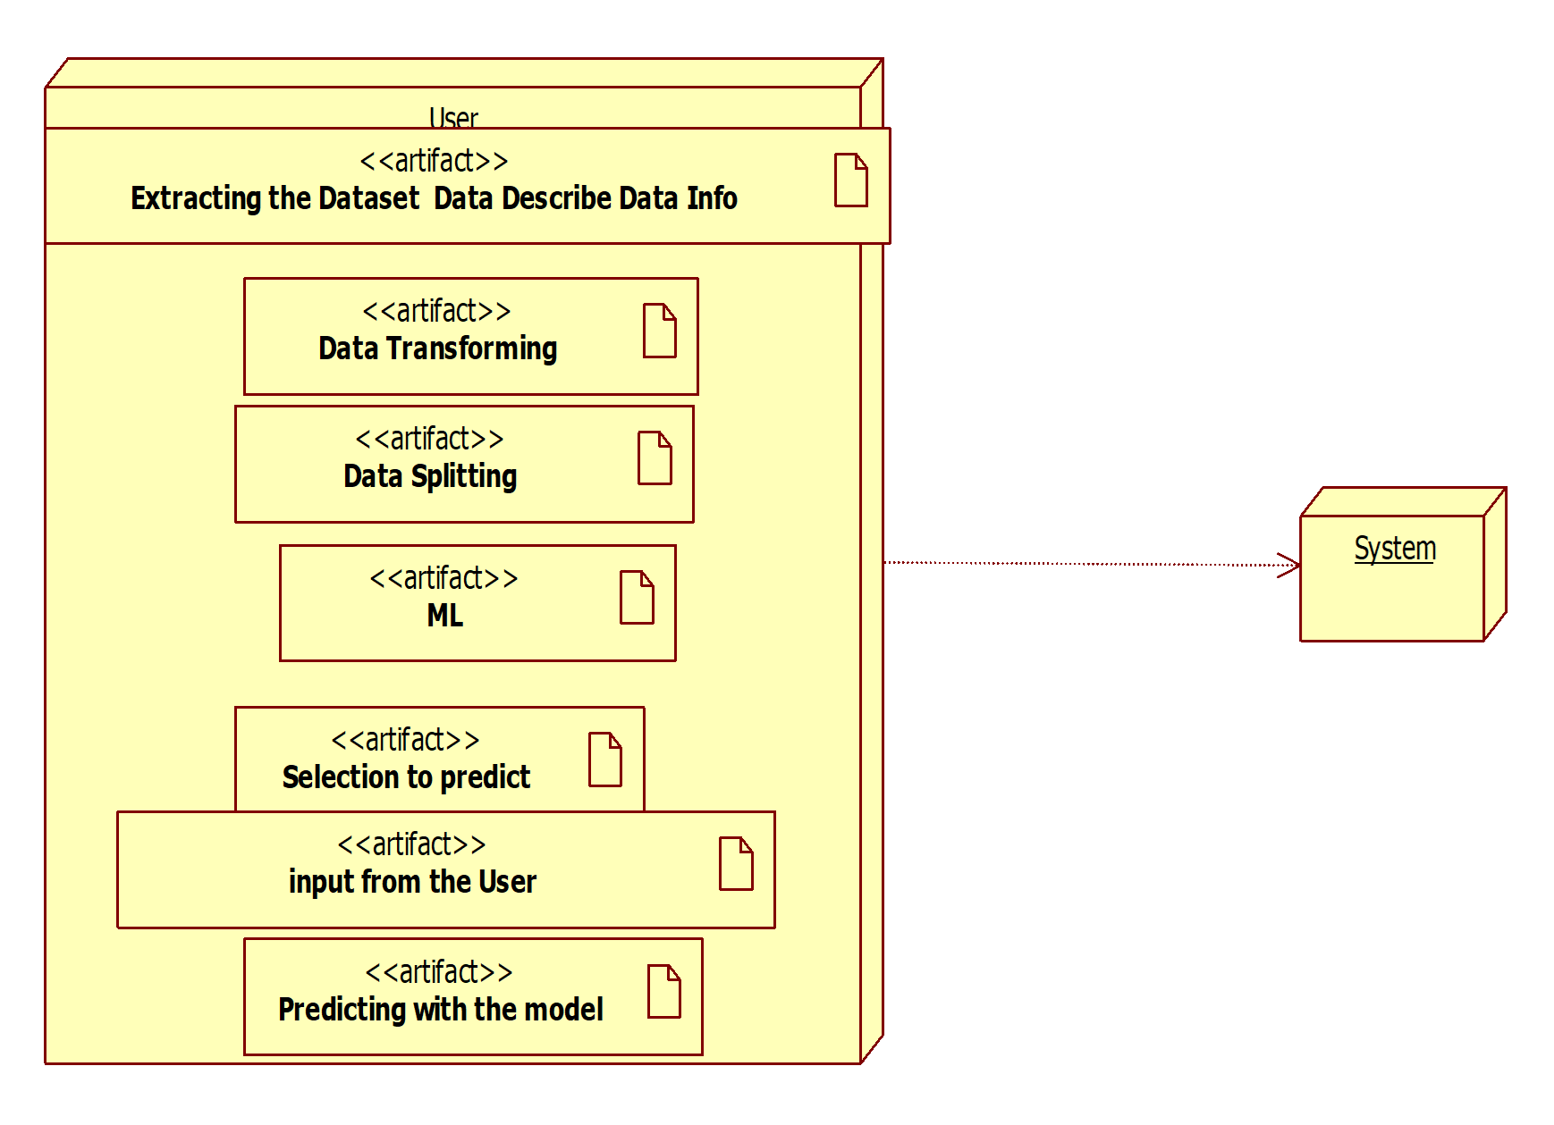
Component Diagram

Slide 13
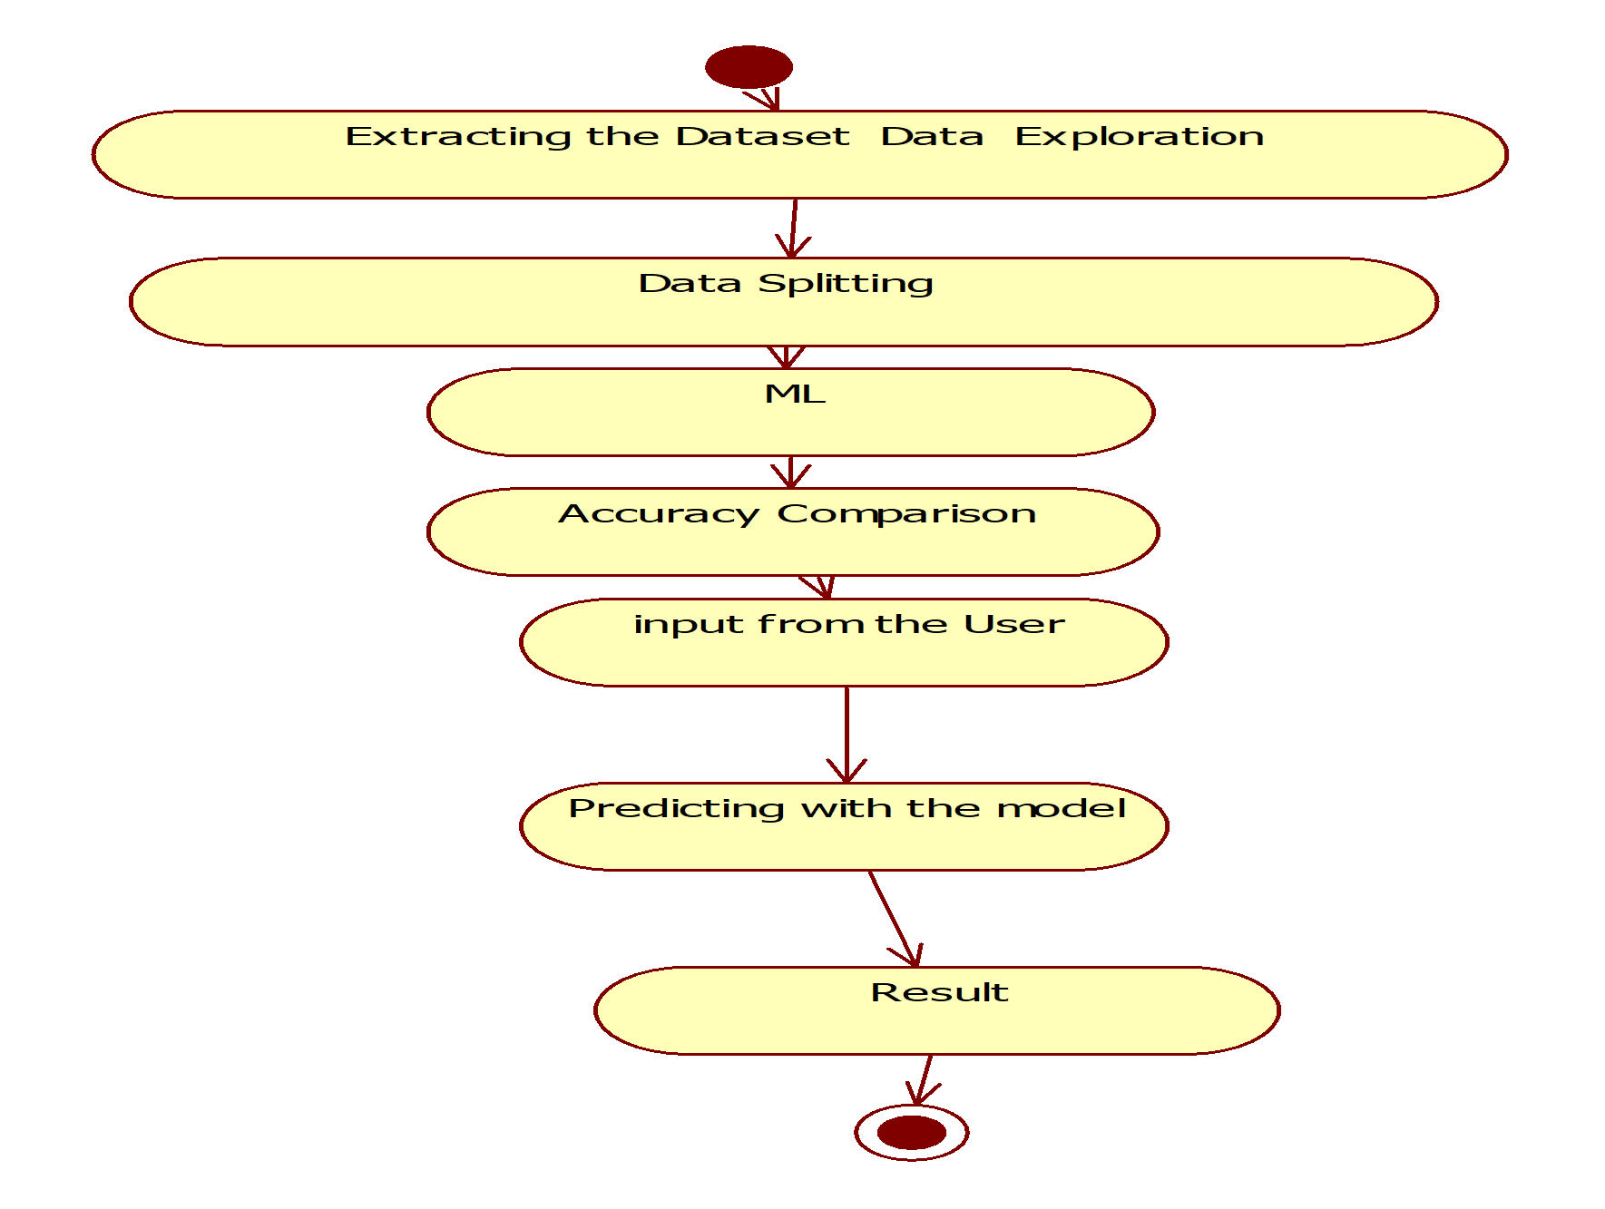
Activity Diagram

Slide 14
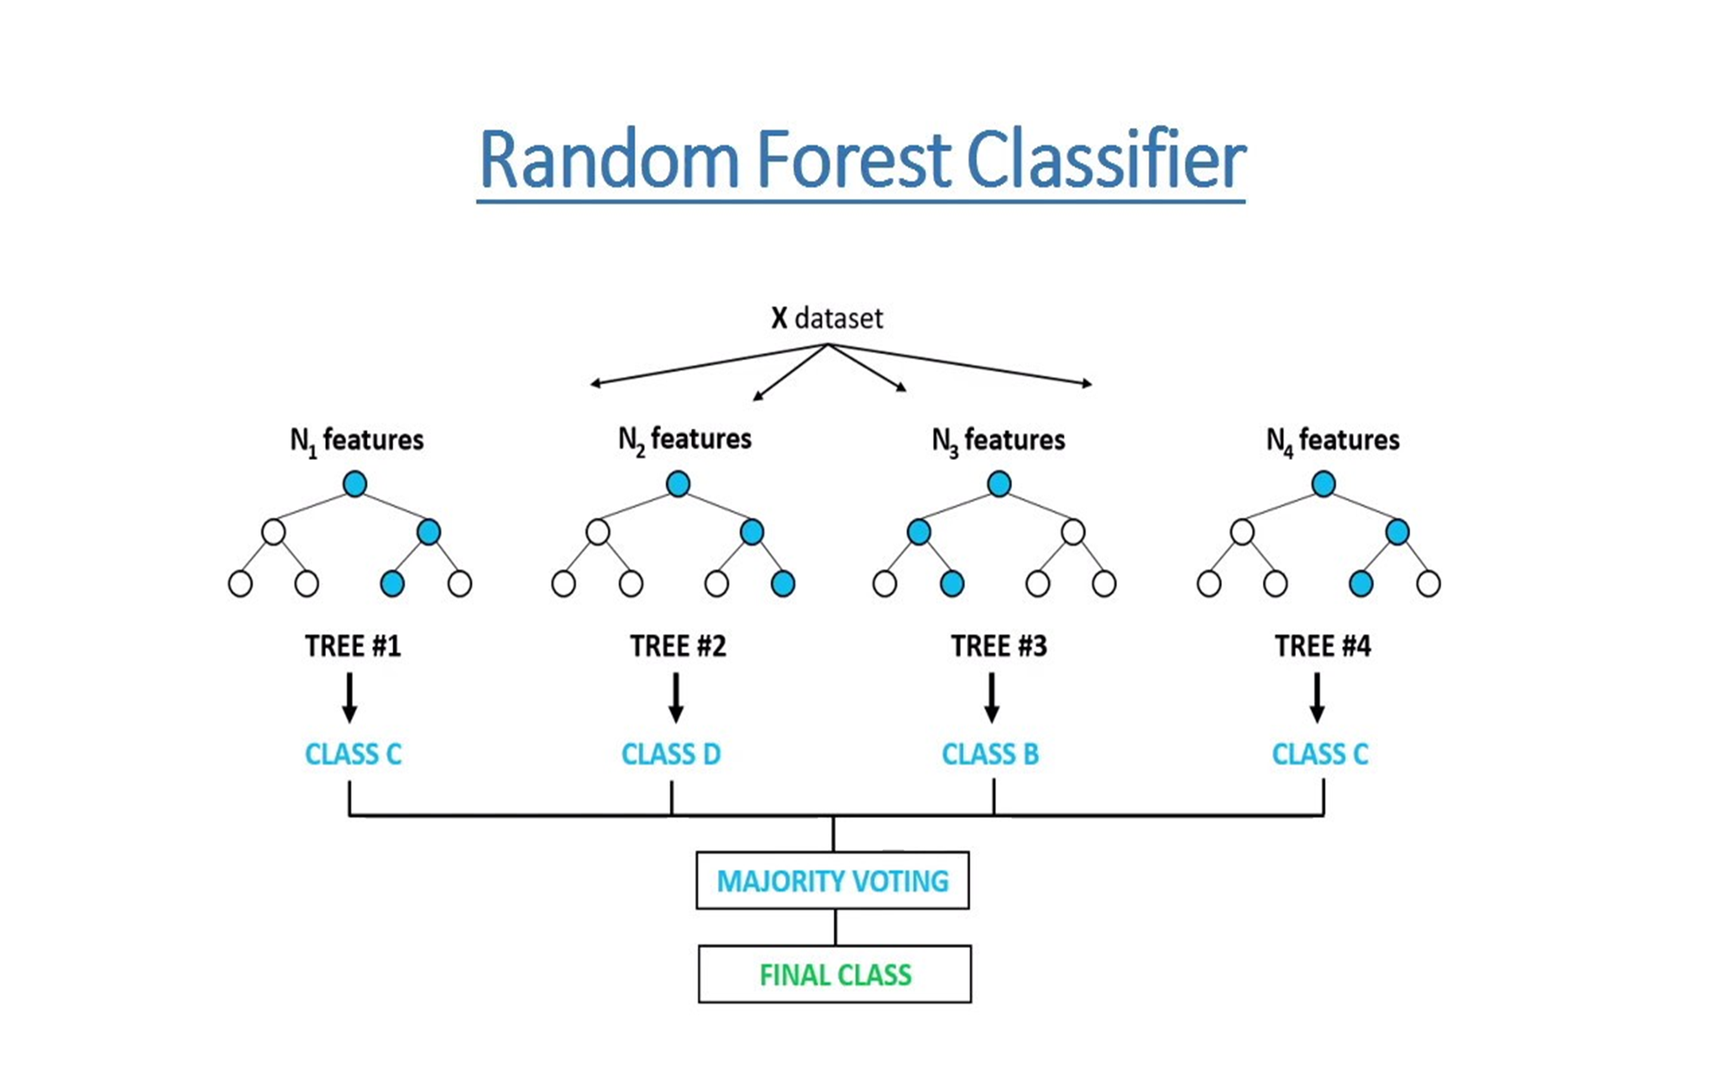
Analysis

Slide 15
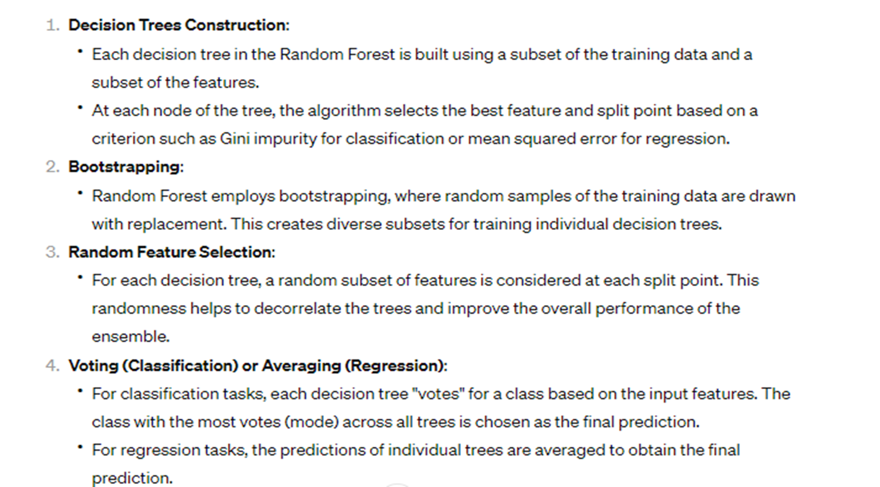
Random Forest is an ensemble learning method that constructs a multitude of decision trees during training and outputs the mode of the classes (classification) or mean prediction (regression) of the individual trees

Slide 16
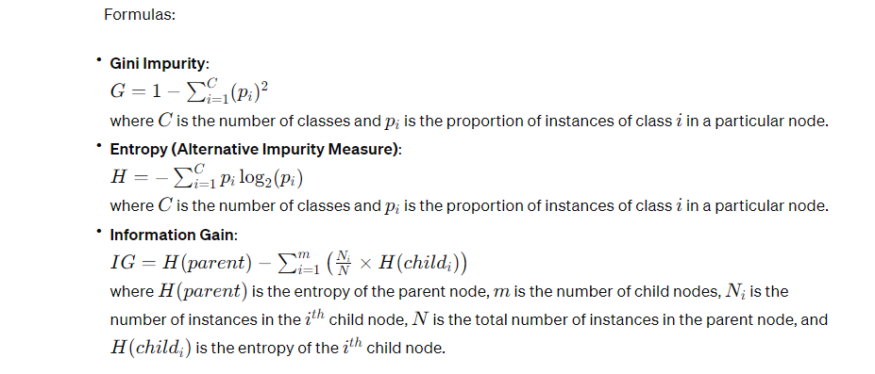

Slide 17
The following steps explain the working Random Forest Algorithm:
Step 1: Select random samples from a given data or training set.
Step 2: This algorithm will construct a decision tree for every training data.
Step 3: Voting will take place by averaging the decision tree.
Step 4: Finally, select the most voted prediction result as the final prediction result.
This combination of multiple models is called Ensemble. Ensemble uses two methods:
Bagging: Creating a different training subset from sample training data with replacement is called Bagging. The final output is based on majority voting.
Boosting: Combing weak learners into strong learners by creating sequential models such that the final model has the highest accuracy is called Boosting.

Slide 18
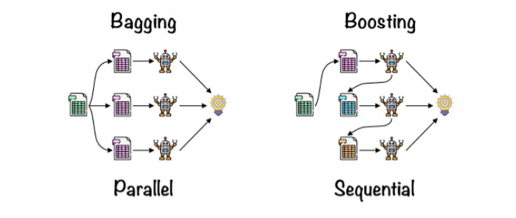
Bagging: From the principle mentioned above, we can understand Random forest uses the Bagging code.
Bagging is also known as Bootstrap Aggregation used by random forest. The process begins with any original random data.
After arranging, it is organized into samples known as Bootstrap Sample. This process is known as Bootstrapping. Further, the models are trained individually, yielding different results known as Aggregation. In the last step, all the results are combined, and the generated output is based on majority voting. This step is known as Bagging and is done using an Ensemble Classifier.

Slide 19
Project Execution Screen Shots

Slide 20
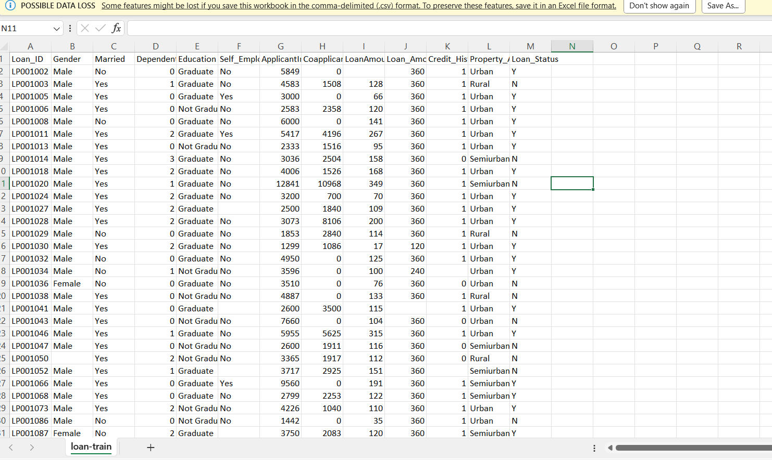
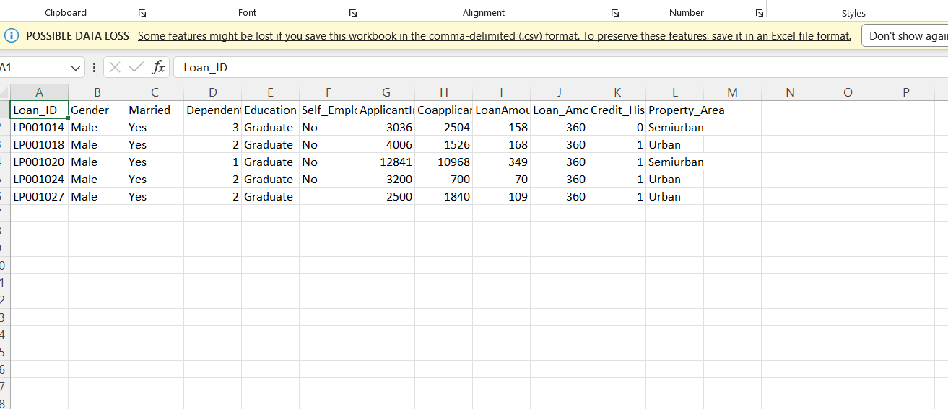
In this project we are using machine learning algorithm called Random Forest to predict loan eligibility and to train this
In above dataset in first row we can see dataset column names and in other rows we have dataset values and in last column we have class label as Y or N where Y means eligible and N means not eligible and now we used above dataset to train machine learning model and after training we will upload test dataset and then application will predict class label Y or N and below is test dataset screen shots

Slide 21
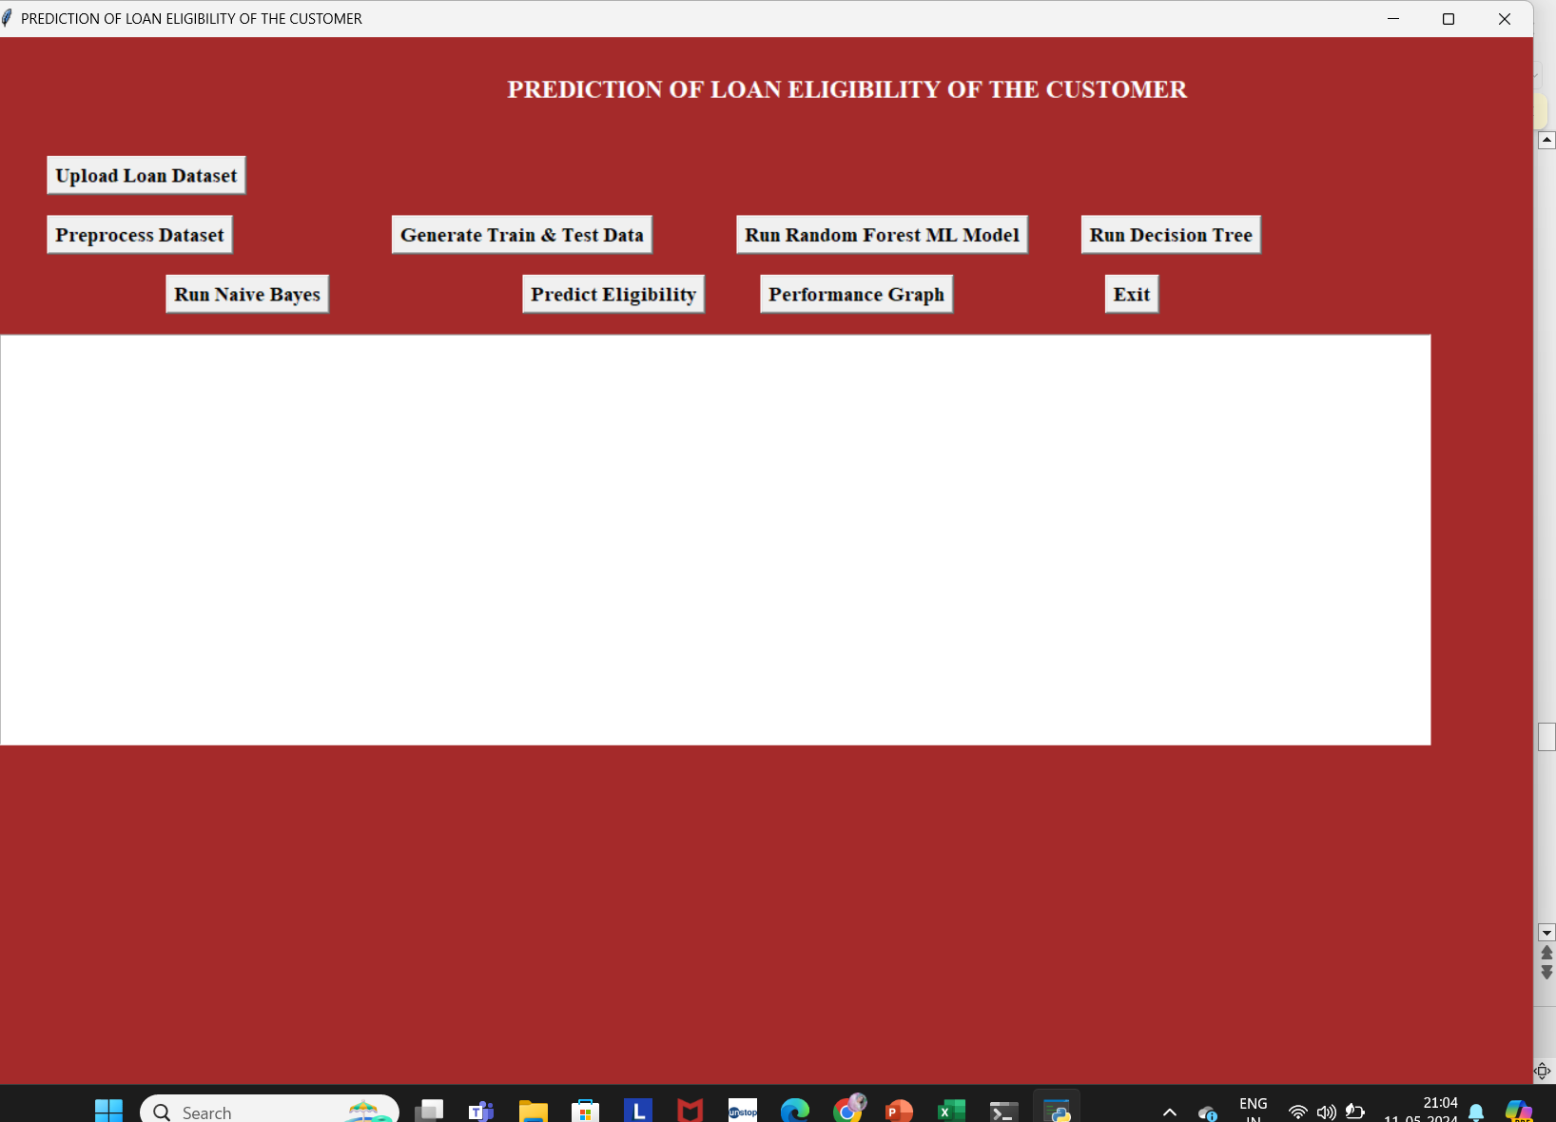
Datasets
The datasets is download from Kaggle
https://www.kaggle.com/
In above screen click on ‘Upload Loan Dataset’ button to load dataset

Slide 22
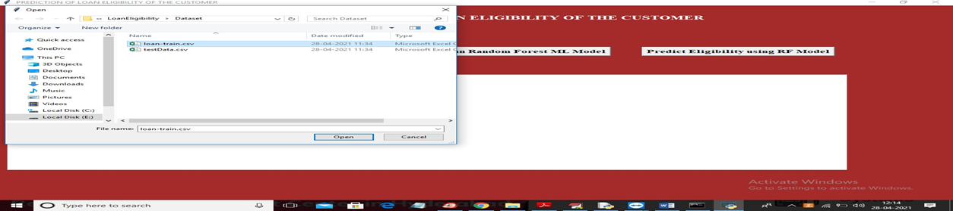
Datasets
In above screen selecting and uploading ‘loan-train.csv’ file and then click on ‘Open’ button to load dataset and to get below screen

Slide 23
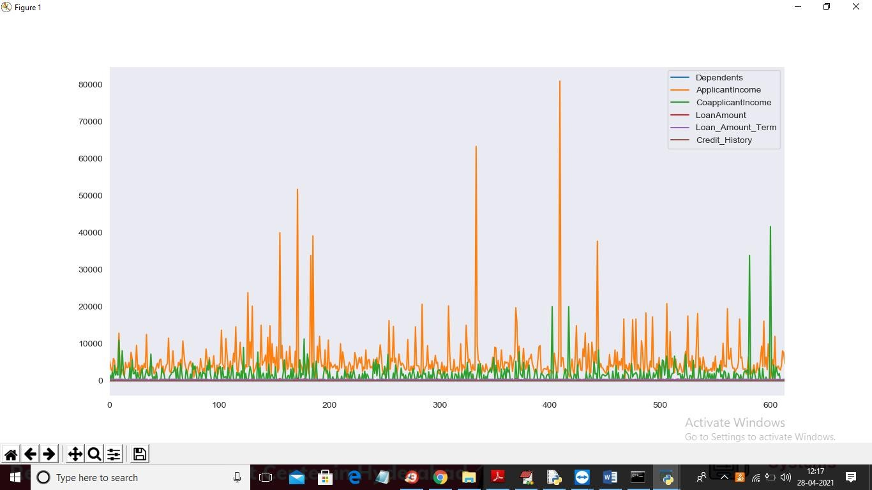
In above graph different colour lines represents counts of that column and you can see column names with colour in graph top right side. Now click on ‘Preprocess Dataset’ button to clean dataset

Slide 24
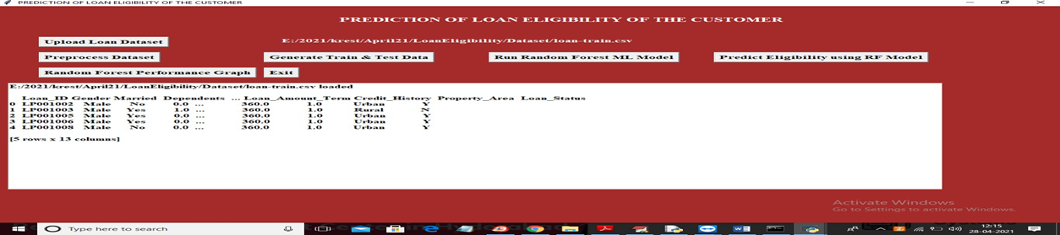
In above screen dataset loaded and all columns contains non-numeric values and machine learning will not accept non-numeric values so we need to convert all those values to numeric by assigning ID’s to them where MALE will replace with 0 and FEMALE will replace with 1 and below graph showing number of different values in dataset

Slide 25
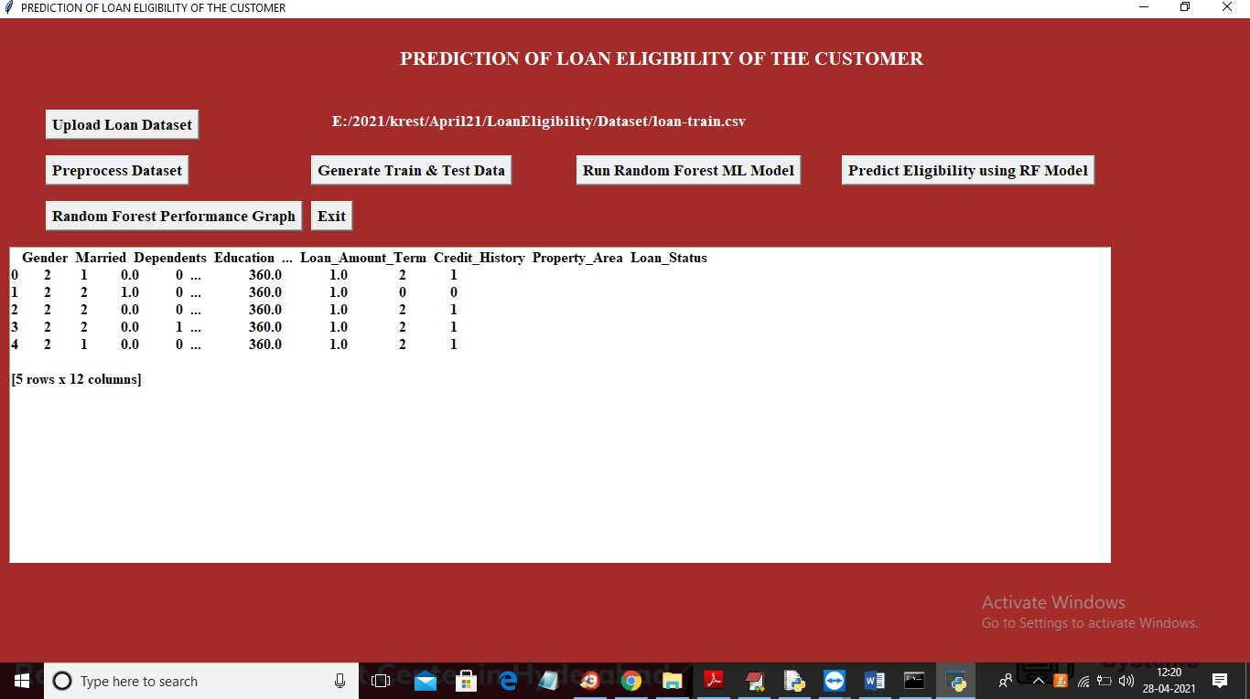
In above screen all non-numeric data is replace with numeric values and now click on ‘Generate Train & Test Data’ button to split dataset into train and test part

Slide 26
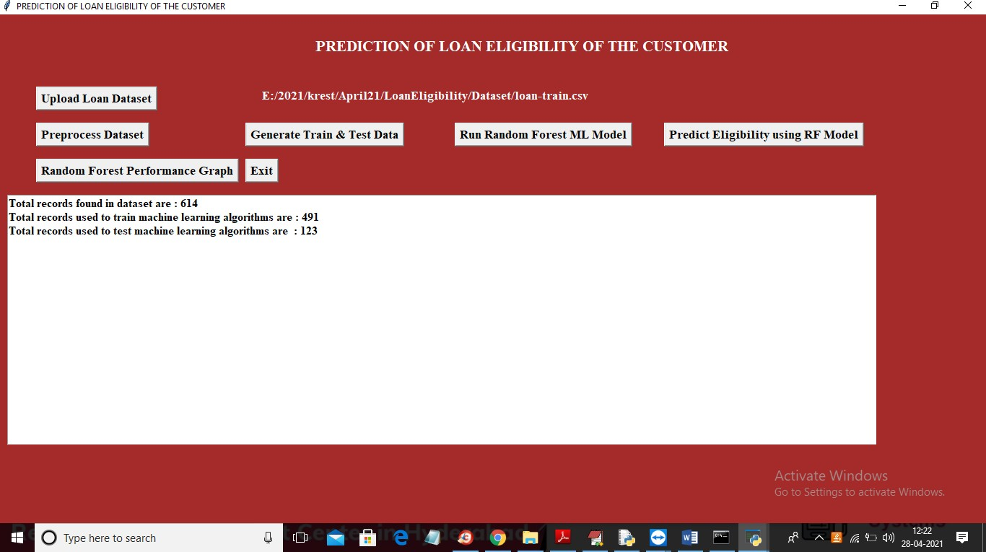
In above screen dataset contains 614 records and using 491 records to train ML and 123 records to test ML accuracy. In below graph we can see importance of each attribute with other attribute by using graph correlation metric

Slide 27
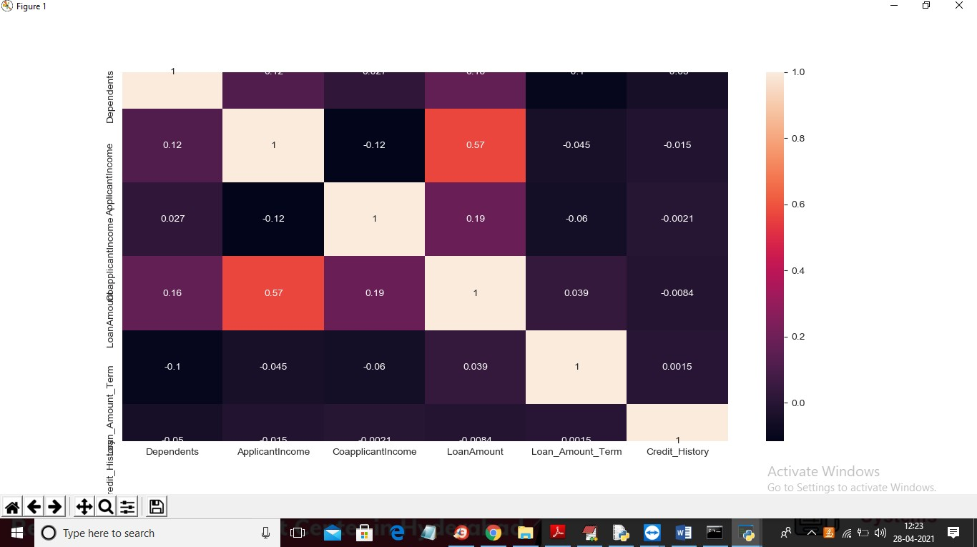
In above graph whatever column in x-axis and y-axis having value >0 will be consider as important features or column. Now click on ‘Run Random Forest Ml Model’ to build random forest model on above dataset

Slide 28
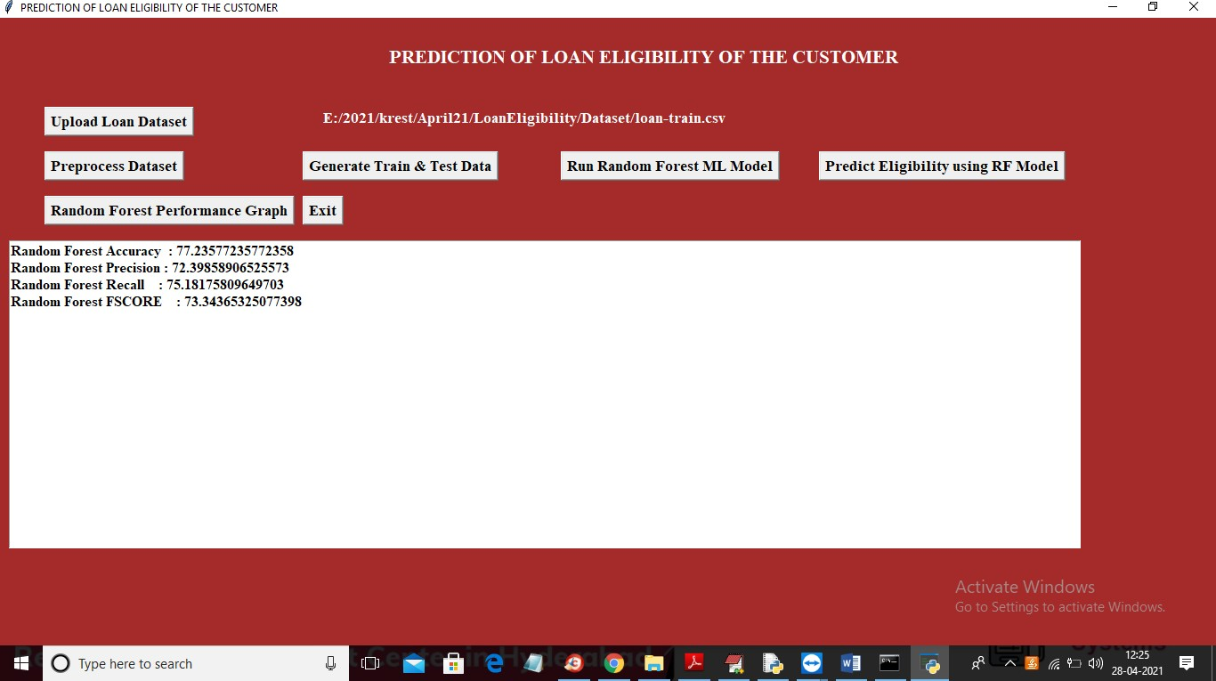
In above screen random forest model generated with 77% accuracy and we can see its precision, recall and FSCORE value and now click on ‘Predict Eligibility using RF Model’ button to upload test data and perform eligibility prediction

Slide 29

In above screen selecting and uploading ‘testData.csv’ file and then click on ‘Open’ button to load test data and then will get below prediction result

Slide 30
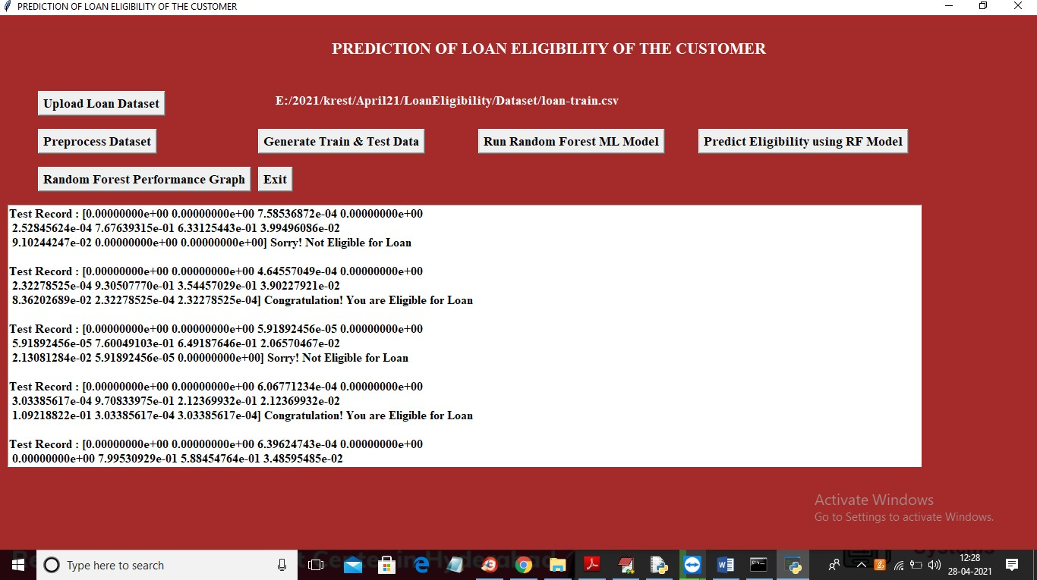
In above screen in square bracket we can see normalized test values and after square bracket we can see the prediction result as eligible or not eligible. You can scroll down above text area to view all predicted records and now click on ‘Random Forest Performance Graph’ button to get below graph

Slide 31
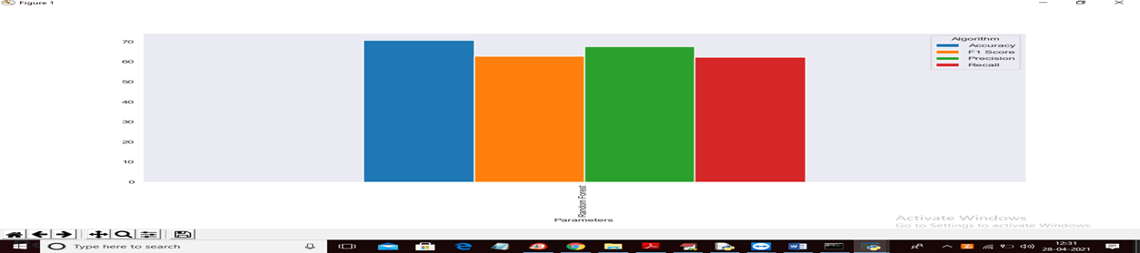
In above graph we can see accuracy, precision, recall and FSCORE values of random forest and graph y-axis represents %value where accuracy got 80% and Precision got 65%. Each metric bar colour name you can see from top right side

Slide 32
conclusion
Therefore, the developed model automates the method of determining the applicant’s creditworthiness. It focuses on an information containing the main points of the loan applicants. In this system random forest model is used. In Machine Learning, random forest analysis is one of the supervised learning algorithm, Hence, it is good for predicting the right result in the current world scenario and also help the bank to give the money in the right hands and also help the people in getting loan in a much faster way. The main advantage of this system is, it gives more accuracy.

Slide 33
Thanks
For
LISTENING

